Slide 1
Polymorphism in Python
DVT101 – Lecture 37
- By Dataverse Tutorials

Slide 2
Introduction to Polymorphism
Meaning of polymorphism (many forms)
Why polymorphism is needed
How it increases flexibility
Role in real-world software

Slide 3
Real-World Analogy
Same action, different behavior
Payment system example
Common interface idea
Business logic flexibility

Slide 4
What Changes in Polymorphism
Same method name
Different object response
Dynamic behavior
Loose coupling

Slide 5
Types of Polymorphism
Compile-time polymorphism
Runtime polymorphism
Language dependency
Python’s dynamic nature

Slide 6
Compile-time Polymorphism in Python
Concept of overloading
Why Python doesn’t support true overloading
How default arguments mimic behavior
Use in utility functions

Slide 7
Runtime Polymorphism
Method overriding concept
Parent and child relationship
Dynamic method resolution
Real-world mapping

Slide 8
Polymorphism with Built-in Functions
One function, many data types
Adaptive behavior
Python dynamic typing
Examples of flexibility

Slide 9
Polymorphism with User Functions
Duck typing concept
Behavior over type
Interface-like design
Reusable logic

Slide 10
Operator Polymorphism
Same operator, different result
Data-type dependent behavior
Operator overloading meaning
Practical examples

Slide 11
Internal Working (Dynamic Dispatch)
How Python chooses method at runtime
Object type checking
Attribute lookup chain
Late binding concept

Slide 12
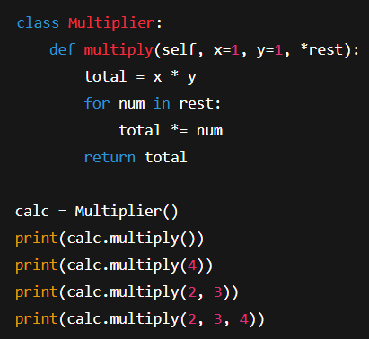
Program Concept: Default Arguments Overloading
Multiple input handling
Single function, multiple forms
Mimicking compile-time behavior
Practical utility

Slide 13
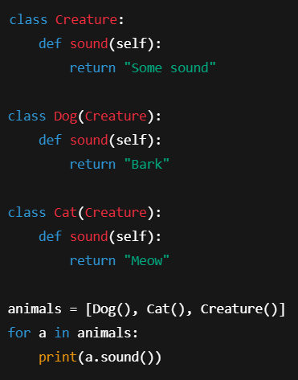
Program Concept: Method Overriding
Parent vs child behavior
Same method, new logic
Runtime decision
Use in frameworks

Slide 14
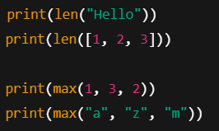
Program Concept: Built-in Polymorphism
len and max adaptability
Type-based logic
Dynamic dispatch
Standard library design

Slide 15
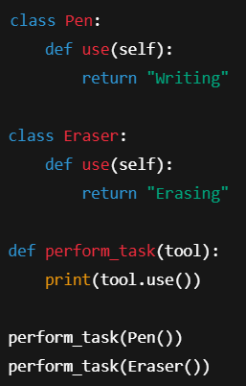
Program Concept: Duck Typing
Behavior-based typing
Common method requirement
Interface-free design
Plugin systems

Slide 16
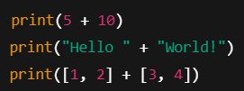
Program Concept: Operator Overloading
Same operator, different meaning
Arithmetic vs concatenation
Collection merging
Expressive code

Slide 17
Real-World Industry Use
Payment gateways
Notification systems
Machine learning pipelines
Microservices

Slide 18
Benefits of Polymorphism
Code reusability
Scalability
Maintainability
Extensibility

Slide 19
Common Mistakes
Wrong method signatures
Forgetting override
Type assumptions
Debugging challenges

Slide 20
Summary
Same interface, different behavior
Compile vs runtime
Built-in and custom
Operator flexibility

Slide 21
Learning Path Forward
Inheritance + polymorphism
Design patterns
Real projects
Interview readiness

Slide 22


